Slide 1
FACIAL EXPRESSION RECOGNITION SYSTEM
Name: Arpit Kumar
Reg. No: 15352116

Slide 2
CONTENTS
Facial Expressions
What is Facial Expression Recognition System ?
Why to use ?
Basic Structure of facial expression recognition
Level of Description
K-Means Clustering
CNN (Convolutional Neural Networks)
KNN
Aim of Dataset
Flowchart
Approaches

Slide 3
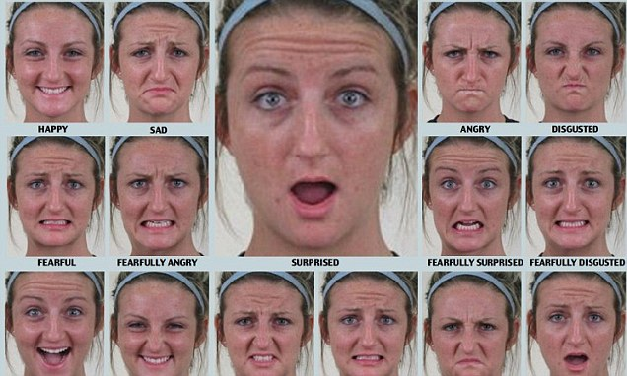
FACIAL EXPRESSIONS

Slide 4
What is it ?
A facial expression recognition system is a computer application for automatically identifying or verifying a person from a digital image or a video frame from a video source. One of the ways to do this is by comparing selected facial features from the image and a facial database.

Slide 5
Why to use ?
It is typically used in security systems and it can be use in social networking site at real time emoji and it will be use to select or play the music according to the mood.

Slide 6
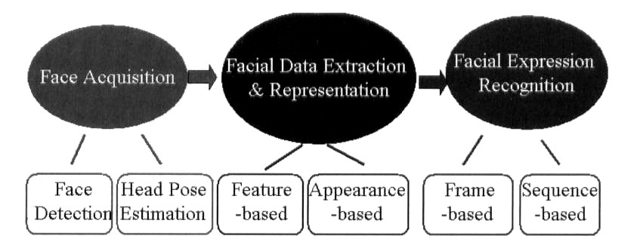
Basic Structure of Facial Expression Recognition System
The general approach to automatic facial expression analysis concept of three steps: face acquisition, facial data extraction and representation and facial expression recognition.

Slide 7
Level of Description
To capture of human emotion and paralinguistic communication automated recognition of fine- grained changes in facial expression is needed.
The facial action coding system (FACS) is human observer based system designed to detect the facial features.

Slide 8
Support Vector Machine (SVM)
In SVM there are some classes and these classes are segregate by a straight line is called Hyper-plane or Margin.SVM is used for both classification and regression problem. In SVM is used for the small amount of data in binary classification and for large amount of data in Multiclass classification. It is used to classify the image.

Slide 9
K-Means Clustering
K-means clustering is a type of unsupervised learning, which is used when you have unlabeled data (i.e., data without defined categories or groups). The goal of this algorithm is to find groups in the data, with the number of groups represented by the variable K. The algorithm works iteratively to assign each data point to one of K groups based on the features that are provided.

Slide 10
CNN (Convolutional Neural Networks )
In machine learning, CNN is a class of deep and feed forward learning. It has been successfully applied to analyze the visual imagery.
CNN is made up of neurons that have learnable weights and biases. As it each neuron receives some inputs. It is in regularization to avoid the overfitting data.

Slide 11
CNN Layer
Dropout Layer
Max Pooling Layer
Activation Layer
Convolutional 2D Layer
Dense Layer
Flatten Layer
Batch Normalization Layer

Slide 12
K-Nearest Neighbour
The k-nearest neighbours algorithm is a non-parametric method used for classification and regression. In both cases, the input consists of the k closest training examples in the feature space. The output depends on whether KNN is used for classification or regression.

Slide 13
Aim of Dataset
The data consists of 48x48 pixel grayscale images of faces. The faces have been automatically registered so that the face is more or less centered and occupies about the same amount of space in each image. The task is to categorize each face based on the emotion shown in the facial expression in to one of seven categories (0=Angry, 1=Disgust, 2=Fear, 3=Happy, 4=Sad, 5=Surprise, 6=Neutral).

Slide 14
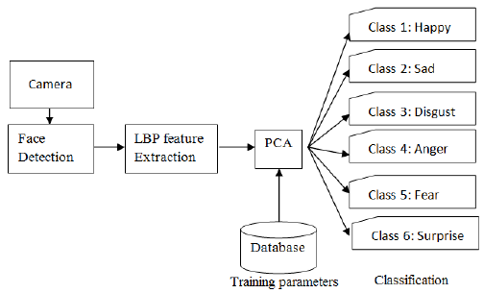
Flowchart

Slide 15
Approaches
Image Acquisition : Images used for facial expression recognition are static images or image sequences. An image sequence contains potentially more information than a still image.
Pre-Processing : Expression representation can be sensitive to translation, scaling and rotation of the head in an image.
Feature Extraction : Feature extraction converts pixel data into a higher-level representation of shape, motion, color, texture of the face or its components. The extracted representation is used for subsequent expression categorization.
Classification : Expression categorization is performed by a classifier. The two main type of classes used in facial expression recognition are action units and the prototypic facial expressions. The 6 prototypic expressions relate to the emotional states of happiness, sadness, surprise, anger, fear and disgust.
Post-Processing : Post-processing aims to improve recognition accuracy, by exploiting domain knowledge to correct classification errors.

Slide 16


